Slide 1
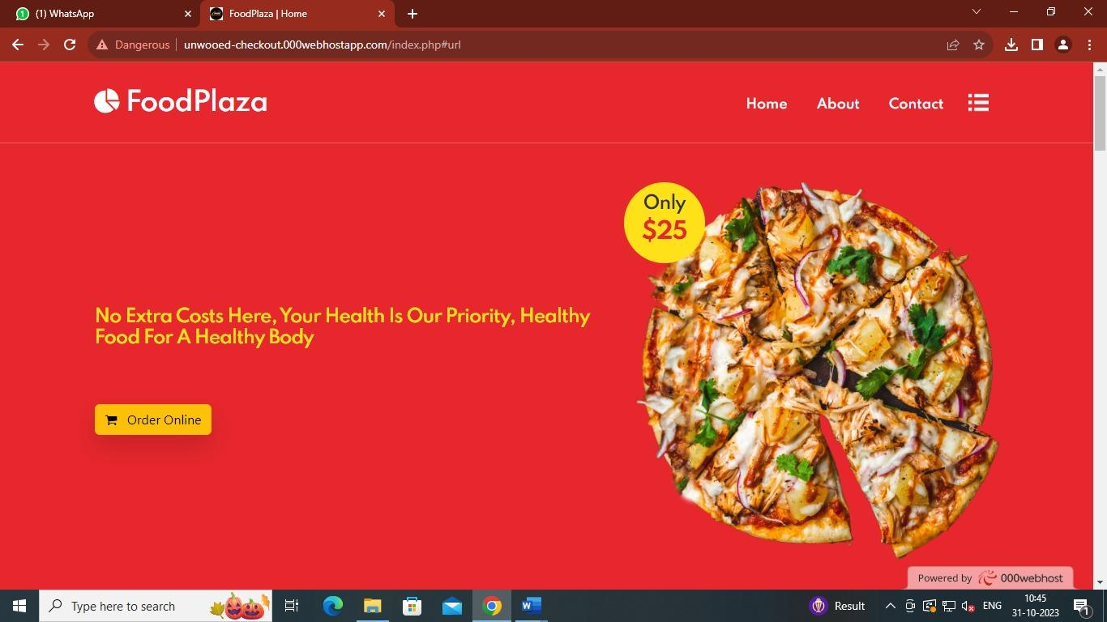

Slide 2
Developed By
Name- Bappa Bairagya
Roll no. -26601221012
Registration- 212661001210007 of 2021-22
Guided By
Name- Rahul Dasgupta
Roll no. -26601221007
Registration- 212661001210016 of 2021-22
Sudipta Ghosh ,mam
Project Trainer
Name- Archisman Gupta
Roll no. -26601221023
Registration- 212661001210041 of 2021-22
Name- Arnab Nandan
Roll no. -26601221028
Registration- 212661001210048 of 2021-22

Slide 3
Acknowledgment
We feel immense pleasure to introduce Food Plaza as our minor project.
We would like to express our special thanks to our teacher Mrs. Sudipta Ghosh , mam who has been a constant source of knowledge and inspiration to us, and who gave us the opportunity to do this project. We would also like to express our gratitude to our beloved parents for their review and many helpful comments and enlightening us and guiding us throughout the finalisation of this project within the limited time frame.
Last but not the least, we thank all our teachers and as well as friends who have given us that much strength to keep moving on forward every time.
Finally, we would like to thank members of the BSTM family for their moral support and encouragement.

Slide 4
Index
DFD
ERD
Limitation
Future scope
Bibliography
Introduction
Abstract
Website Link
Screenshot
coding
Database

Slide 5
Introduction
We are doing our project on an Online Food Delivery system.
Web-based food delivery management application with Online Food Delivery network .
Customers can check different types of foods available through our website
Customers can make orders online.
We provide delicious and fresh food
We have focused to increased online customers to gain more profit

Slide 6
Abstract
A Food delivery portal is a website that manages orders .. The system has 2 Panels
1) Admin Panel.
2) User Panel.
customers can make orders to the admin of the Food Delivery system
Admin review that particular order from the admin panel .
After placing an order all data are going to be recorded in the database for that particular food that customer has made an order.
Admin:
Add Products : Customer use this section , admin can add products from admin panel for the website which will be showing in the frontend
Product List : In this section admin can manage services of the Food ( i.e view , edit-update , search and delete ).
List of Order : In this section admin can view the details of Orders .

Slide 7
Abstract
User:
Home Page : User can visit website. customers can check the food options which are offered by the Food delivery management admin . Customers can order any food available on the website.
About Us : Customers see the details of the Food Delivery system website.
Contact Us : Customers can contact Food Delivery Management directly through the contact details .

Slide 8
Our Website Link
Frontend : https://unwooed-checkout.000webhostapp.com/
Backend : https://unwooed-checkout.000webhostapp.com/admin/login.php

Slide 9
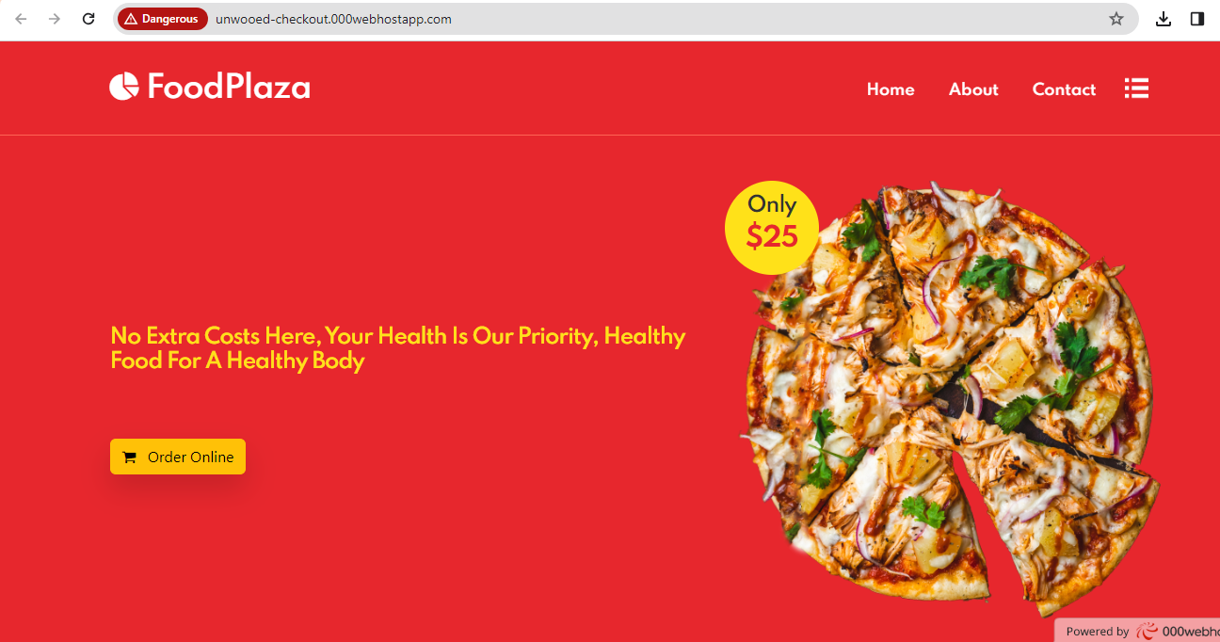
Home Page:

Slide 10
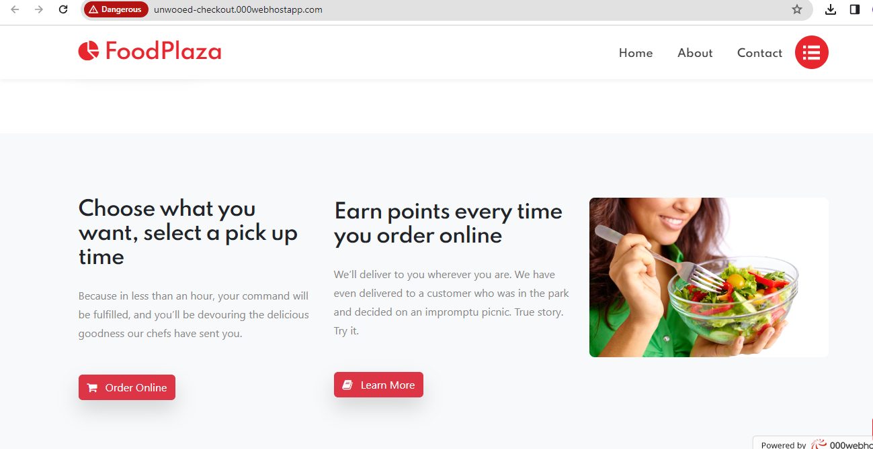
Home Page:

Slide 11
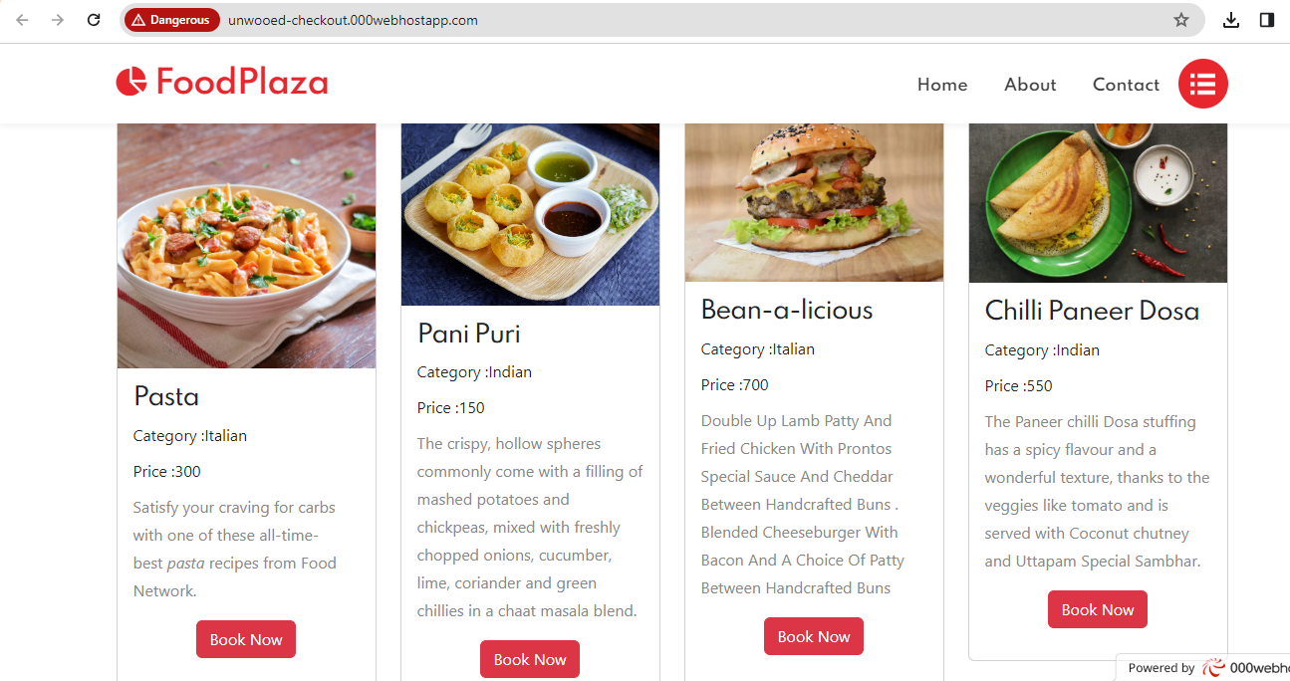
Home Page:

Slide 12
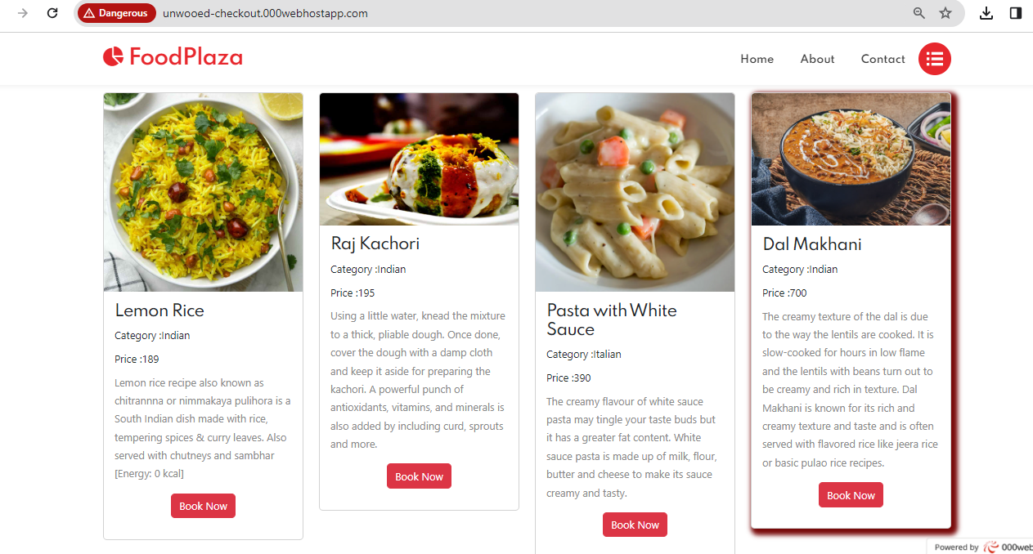
Home Page:

Slide 13
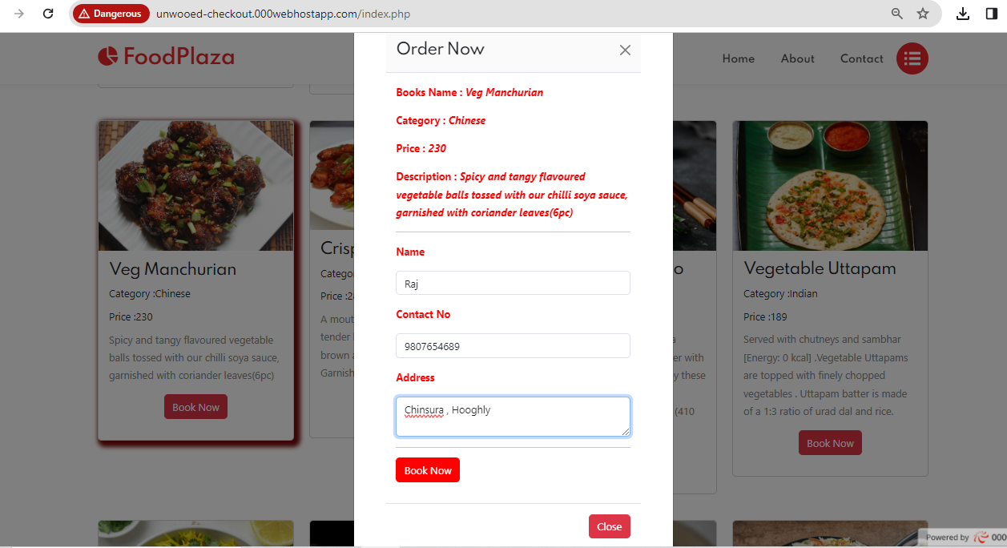
Home Page:

Slide 14
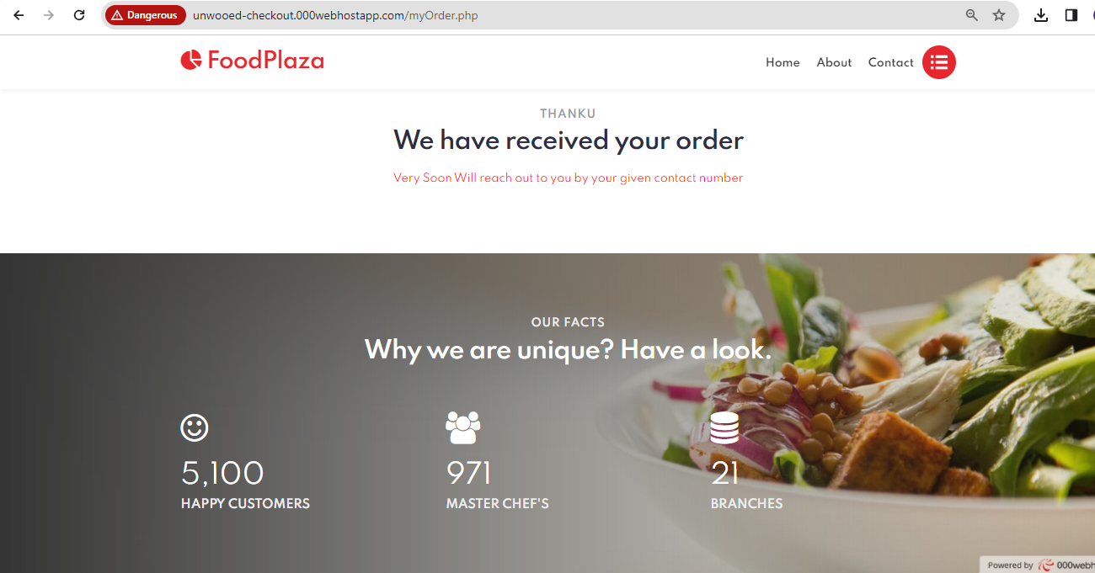
myorder.php:

Slide 15
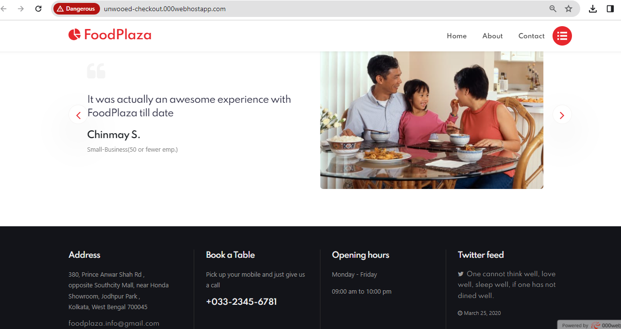
Home Page:

Slide 16
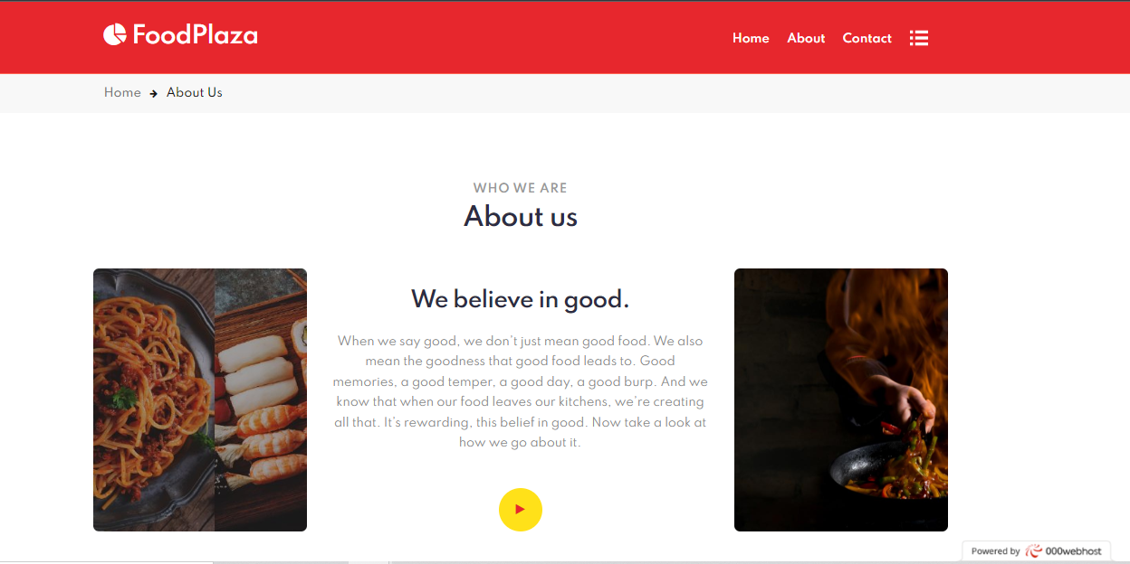
About page:

Slide 17
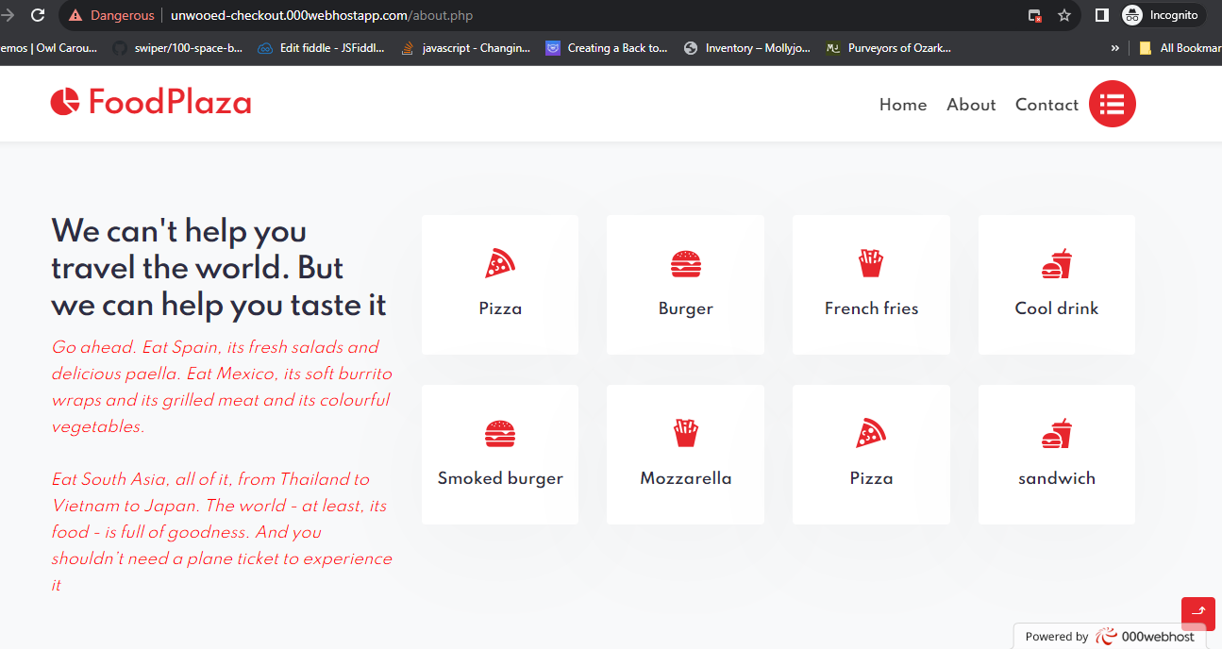
About page:

Slide 18
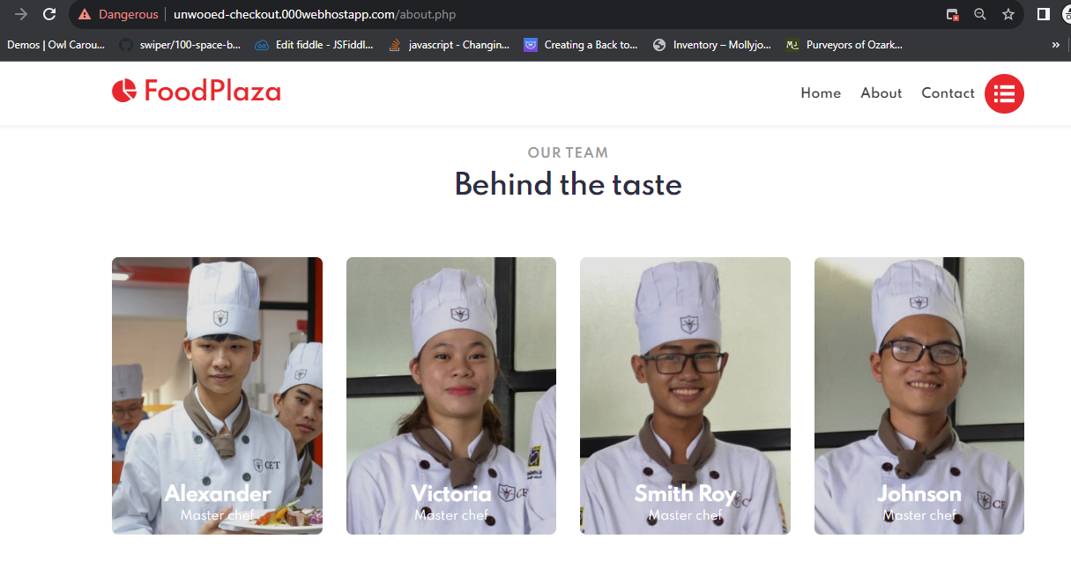
About page:

Slide 19
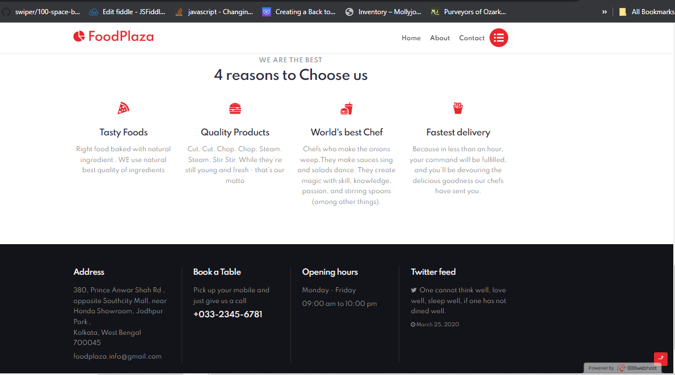
About page:

Slide 20
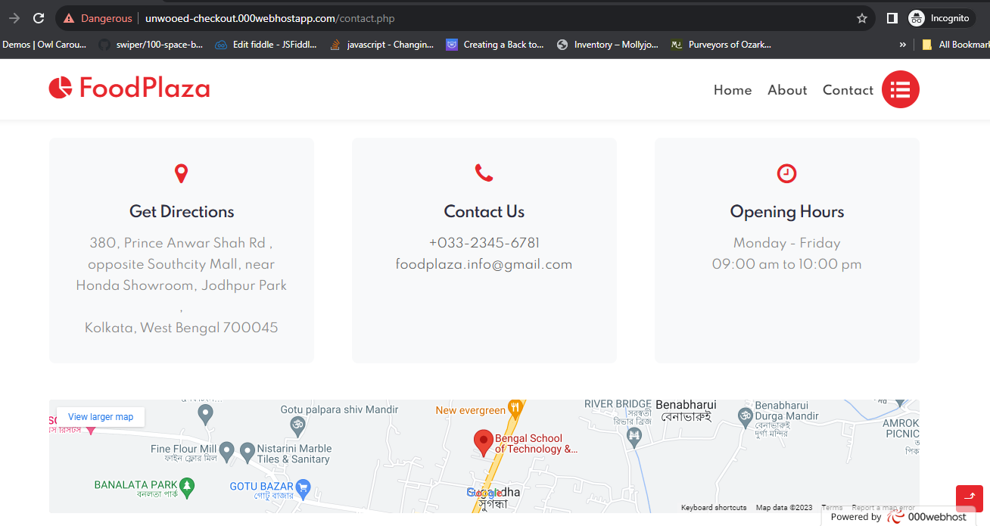
Contact page:

Slide 21
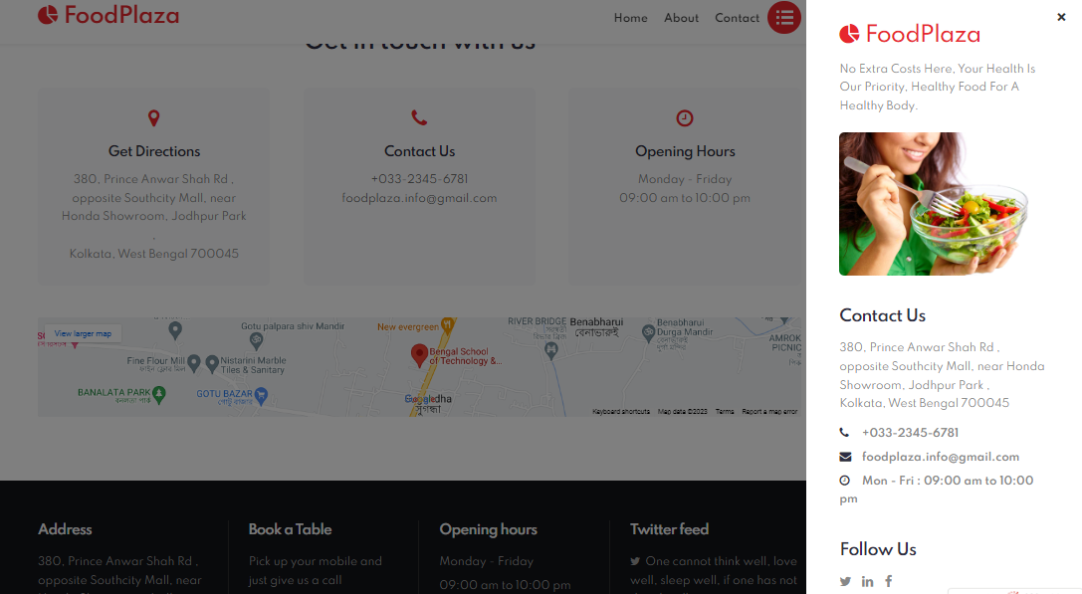
Contact page:

Slide 22
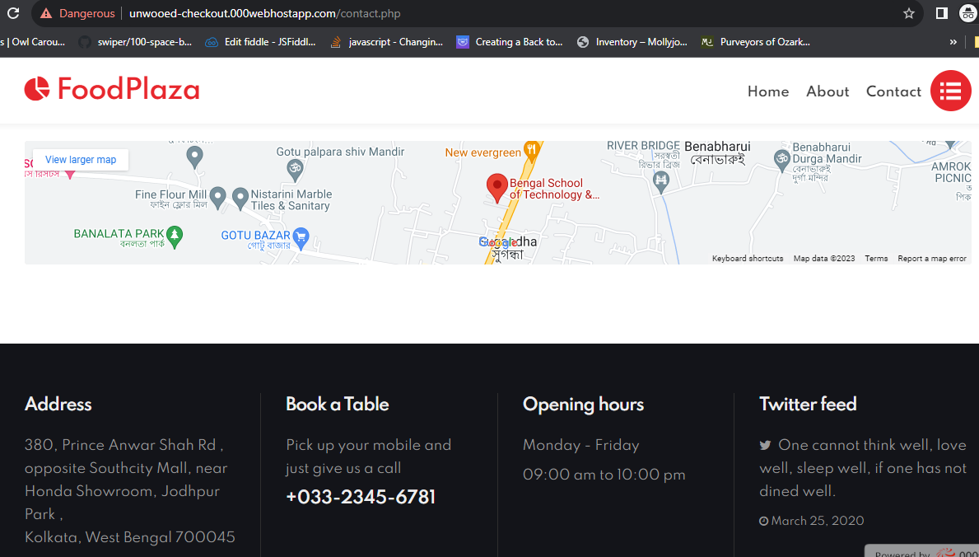
Contact page:

Slide 23
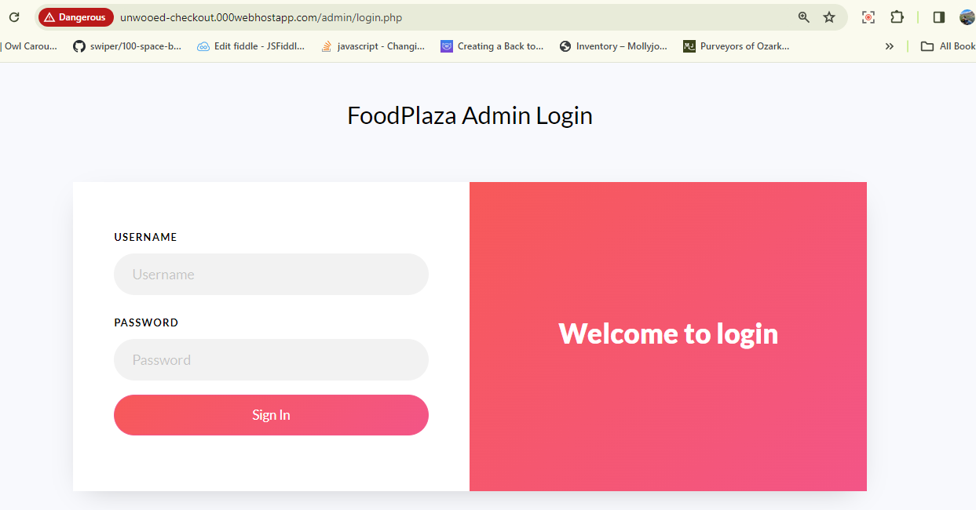
Admin Login :

Slide 24
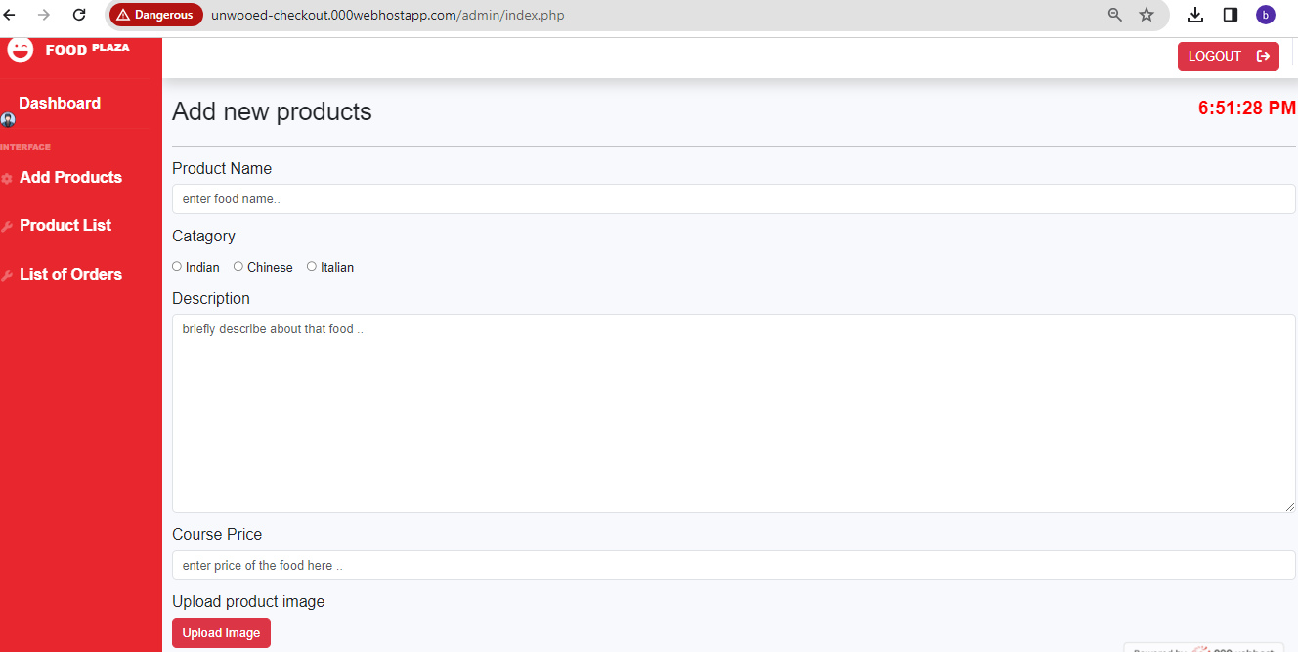
Admin Panel: index.php

Slide 25
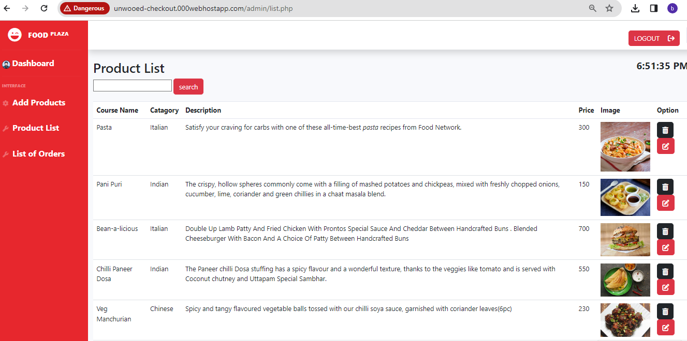
Admin Panel : list.php

Slide 26
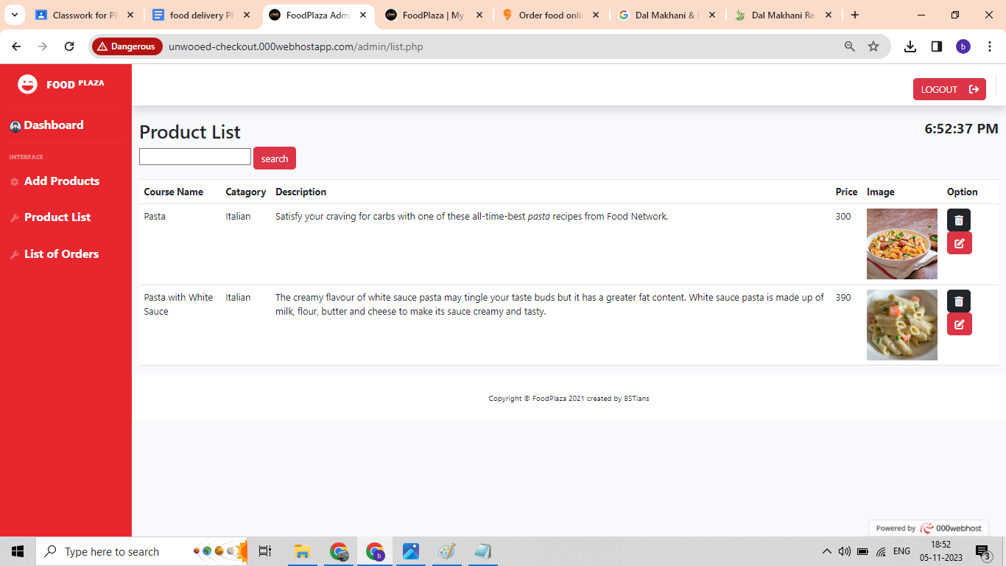
Admin Panel : list.php (search for a particular product by name )

Slide 27
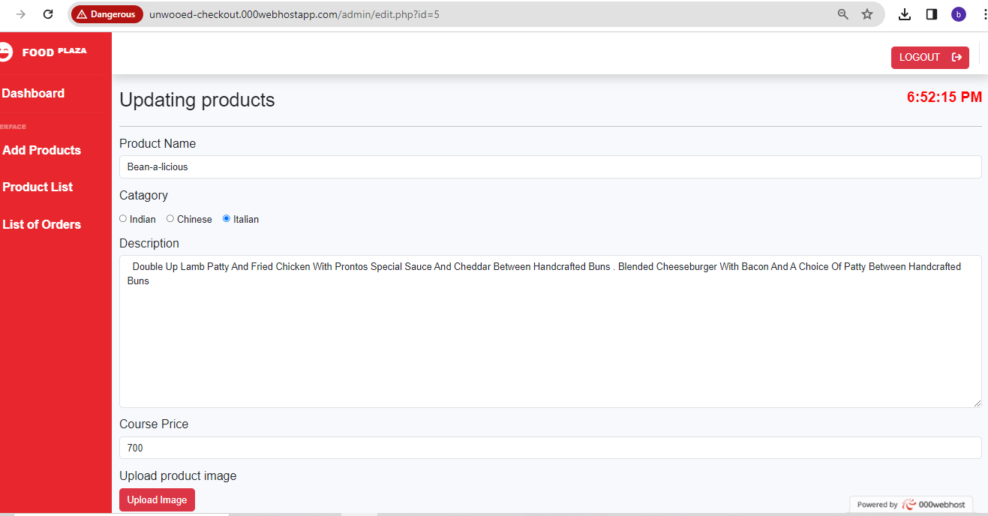
Admin Panel : edit.php ( Edit a particular product by clicking edit button from list.php page)

Slide 28
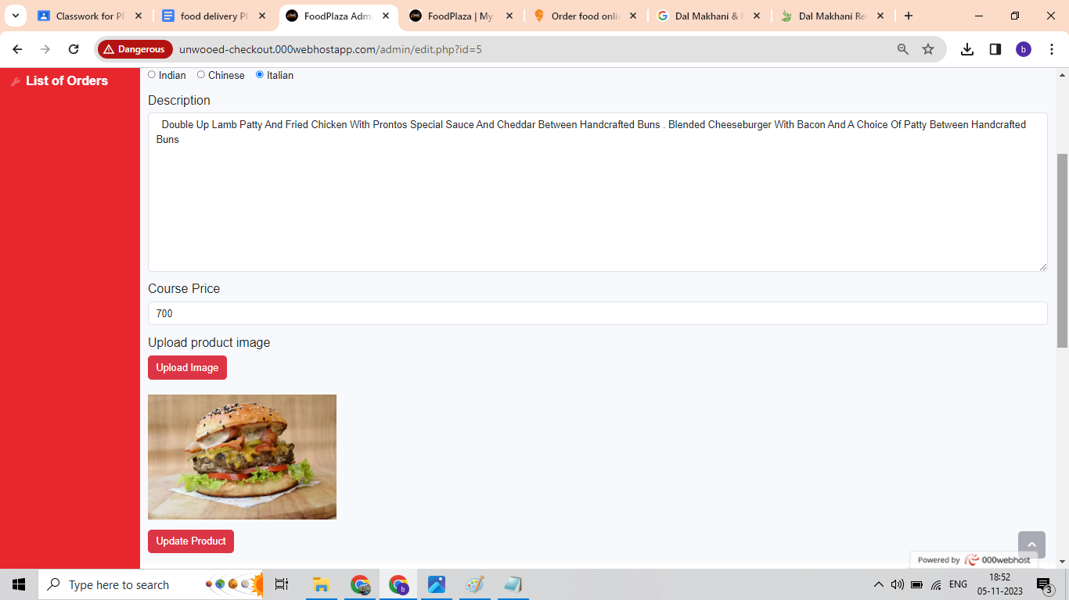
Admin Panel : edit.php ( Edit a particular product by clicking edit button from list.php page)

Slide 29
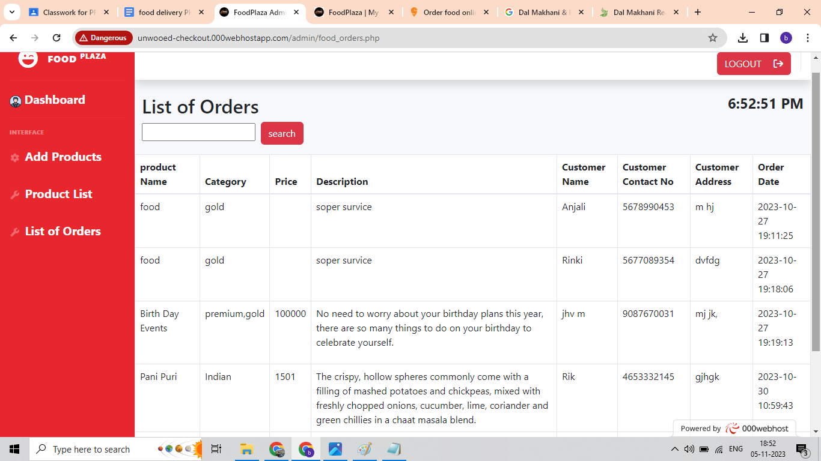
Admin Panel: food_orders.php

Slide 30
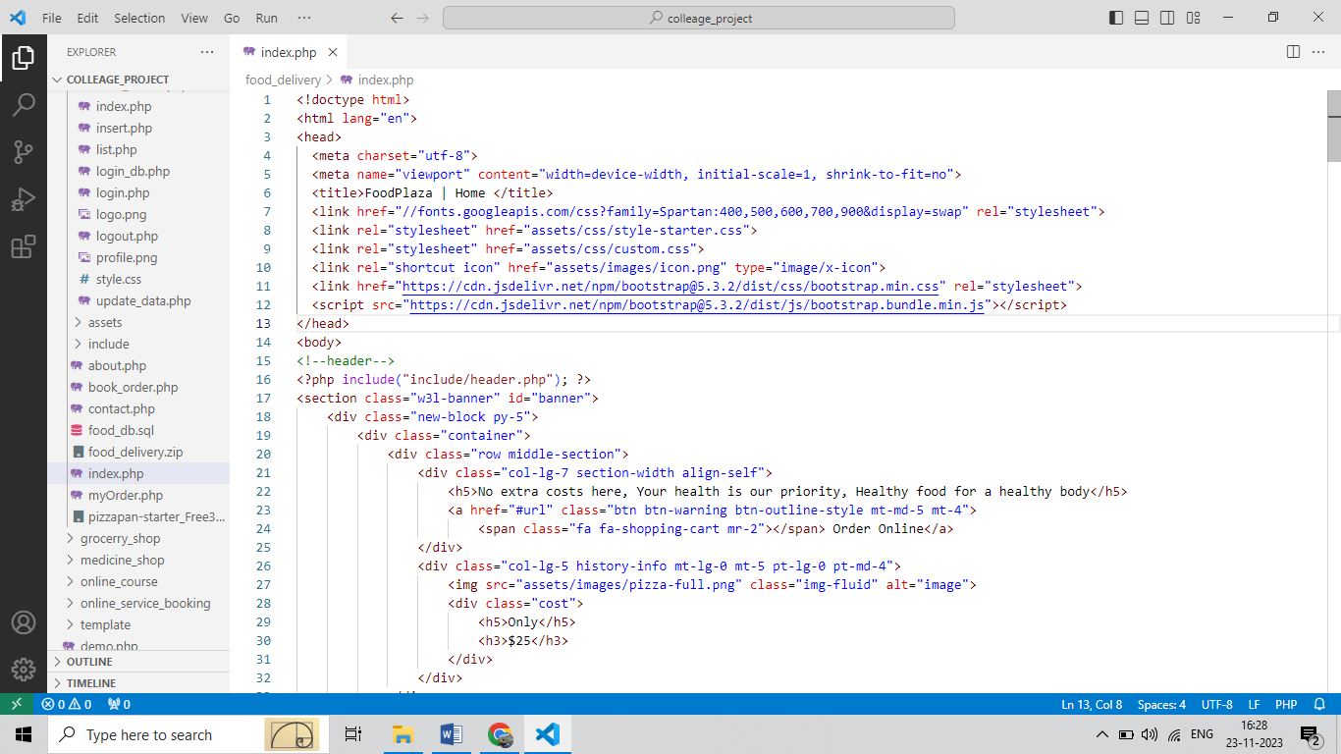
Frontend - Landing Page : index.php

Slide 31
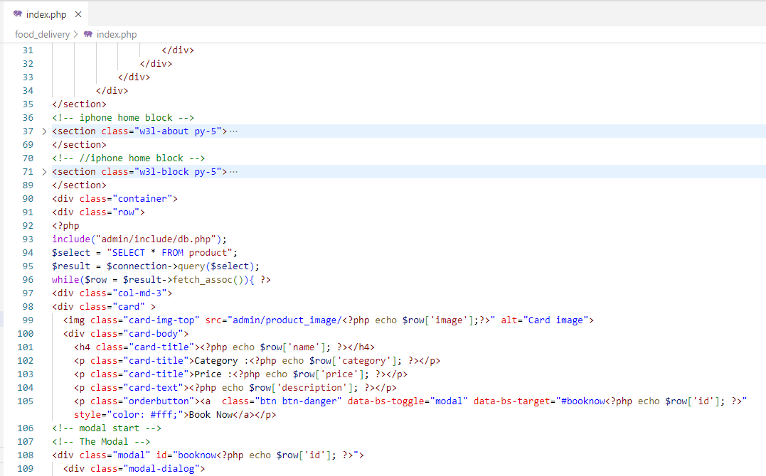
Frontend - Landing Page : index.php

Slide 32
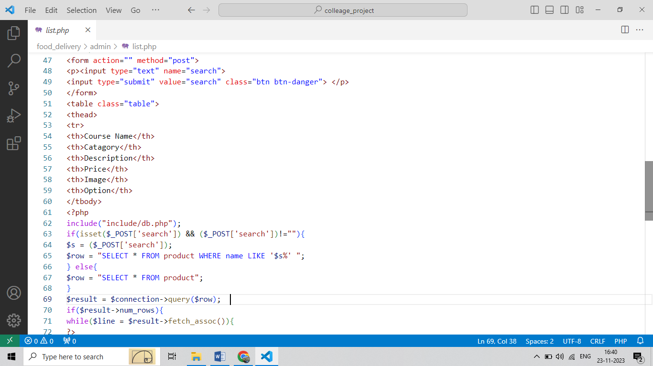
Admin : list.php

Slide 33
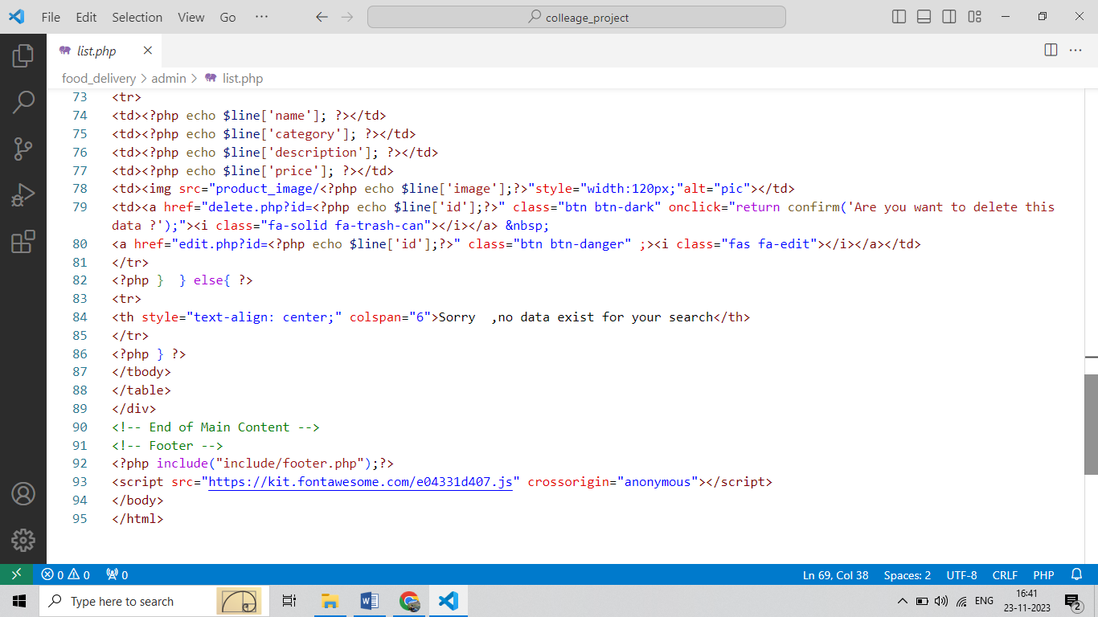
Admin : list.php

Slide 34
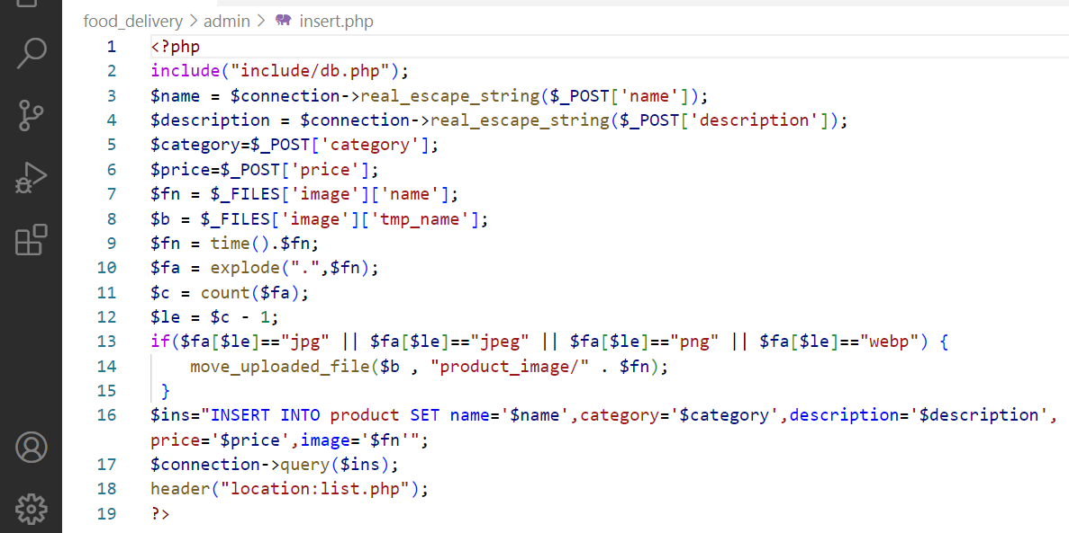
Admin : insert.php

Slide 35
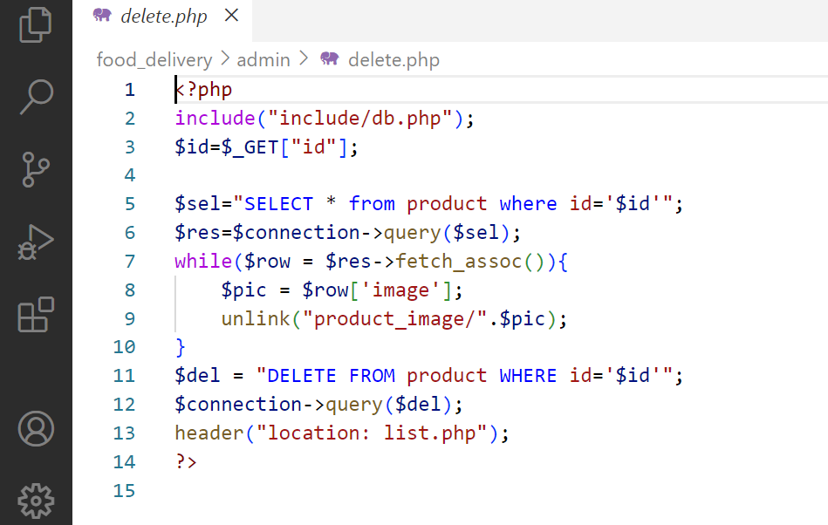
Admin : delete.php

Slide 36
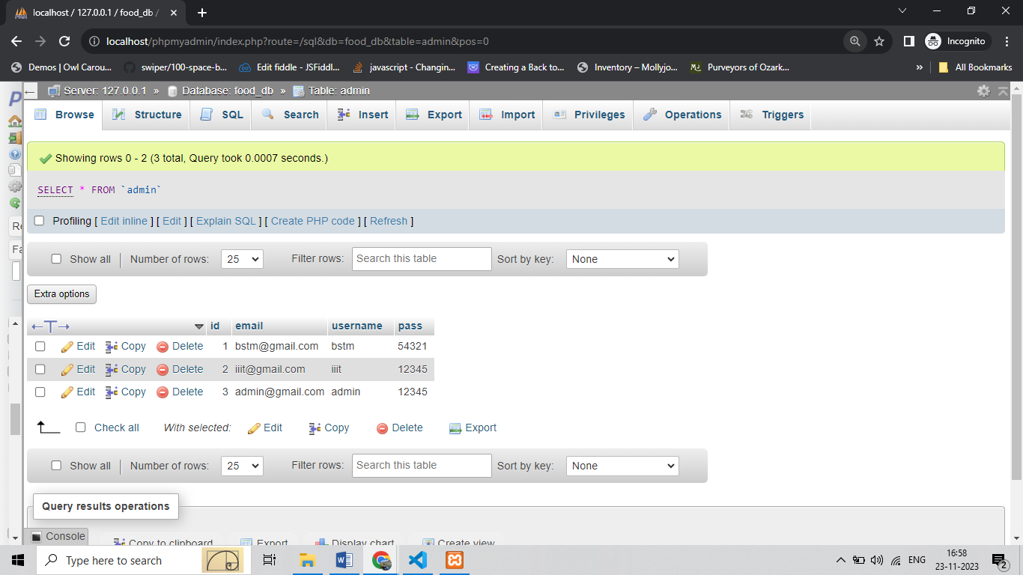
Database :
A database is an organized collection of data stored in a computer system and usually controlled by a database management system (DBMS). The data in common databases is modeled in tables, making querying and processing efficient. Structured query language (SQL) is commonly used for data querying and writing.

Slide 37
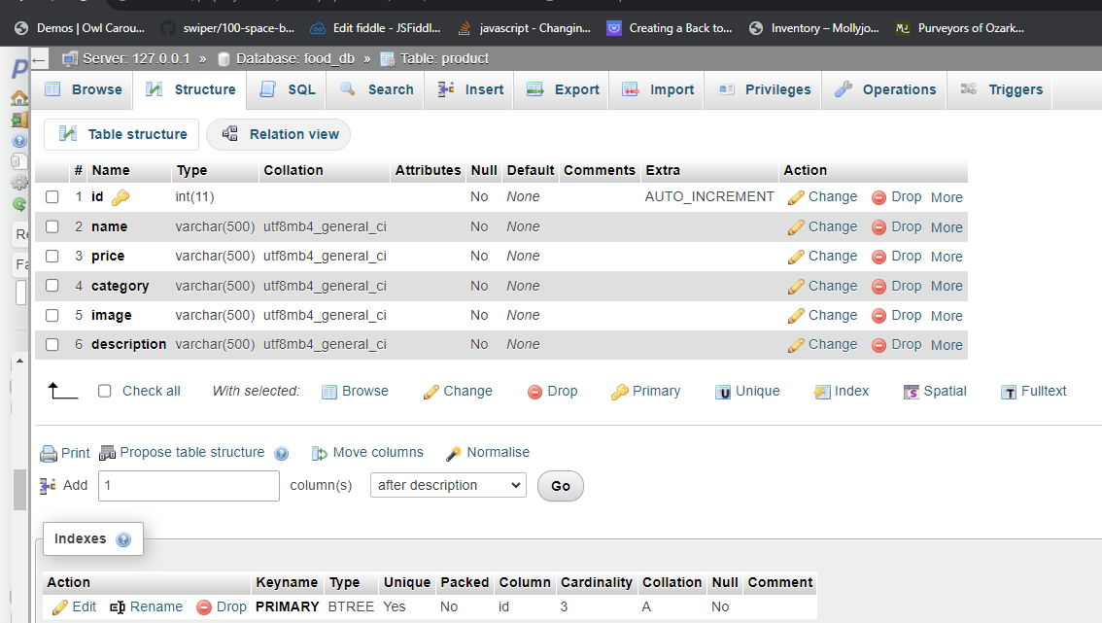
Database :

Slide 38
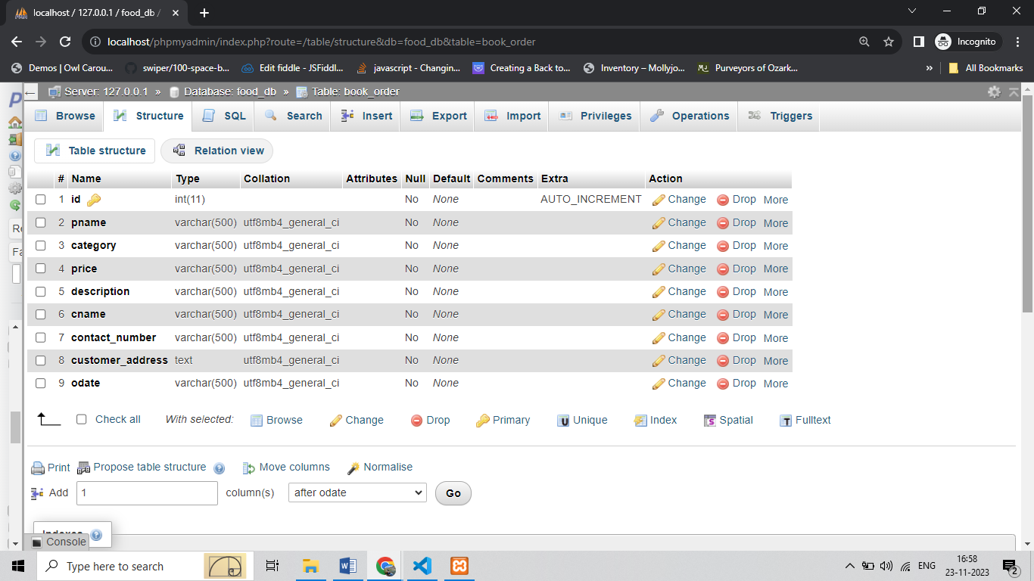
Database :

Slide 39
DFD(Data Flow Diagram)
Login
Food Delivery Management
System
Response
Admin
Customer
Response
Booking
0 Level DFD

Slide 40
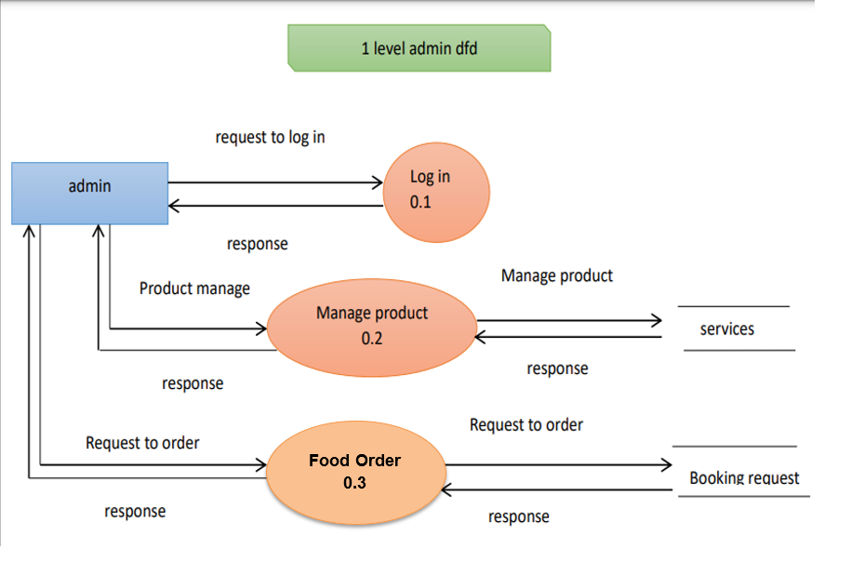
DFD(Data Flow Diagram)

Slide 41
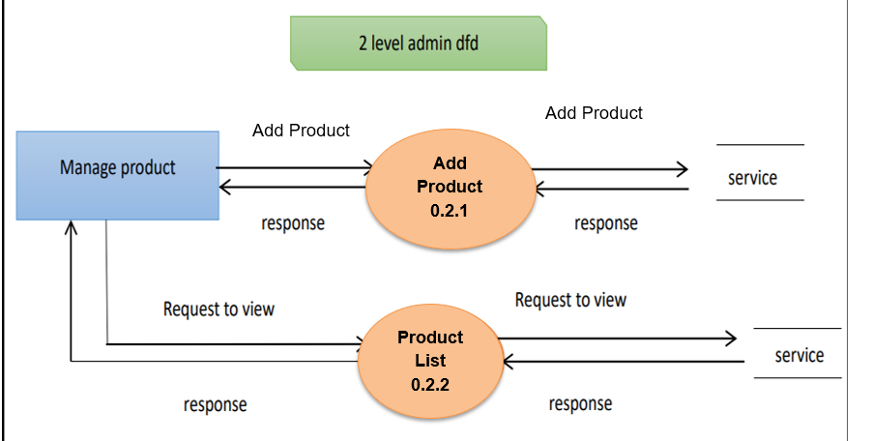
DFD(Data Flow Diagram)

Slide 42
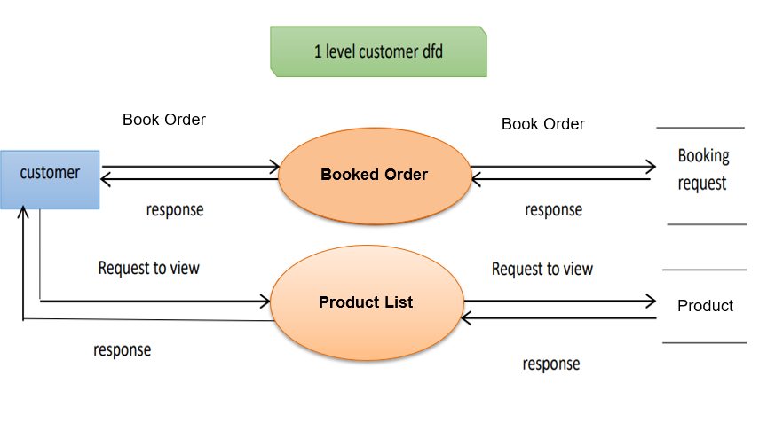
DFD(Data Flow Diagram)

Slide 43
email
name
image
username
description
category
password
_id
_id
admin
manage
product
price
manage
booked
ERD
( Entity Relationship Diagram )
book_order
(booking request)
order
odate
_id
cname
pname
category
description
contact_ number
price
customer_ adders

Slide 44
Limitation
Web Calendar was not integrated which I would like to pursue more time to integrate it in future.
The main feature is an online payment which will be applicable and implemented in the future

Slide 45
FUTURE SCOPE
Integrating payment gateway to the food management website ensures secure payment processing , easy payment checkouts, and generates more sales .
Later we will try to add pagination within our website frontend and backend .
Also Google translator has to be implement in future .
We will try to provide more features so that customers get what they need. This system will try to add more new features. We will try to provide a more user-friendly interface in the future .

Slide 46
BIBLIOGRAPHY
For successfully completing our Project , We have taken help from some websites and books. During the development of the assignment I have used the following books and websites links.
References :
1.https://www.apachefriends.org/
2.https://www.mysql.com/
3.https://www.tutorialspoint.com/php/index.htm
4.https://www.php.net/
5.https://www.w3schools.com/bootstrap5/

Slide 47
Thank You

